Slide 1

Tenant Perception Survey 2024/25

Slide 2
Tenant Satisfaction Measures
The Regulator of Social Housing has created a new system for assessing how well social housing landlords in England are doing at providing good quality homes and services.
In addition to introducing revised consumer standards, this involves a set of tenant satisfaction measures that social housing landlords must report on.
The regulator and residents will be able to use these measures to understand how well landlords are doing.

Slide 3
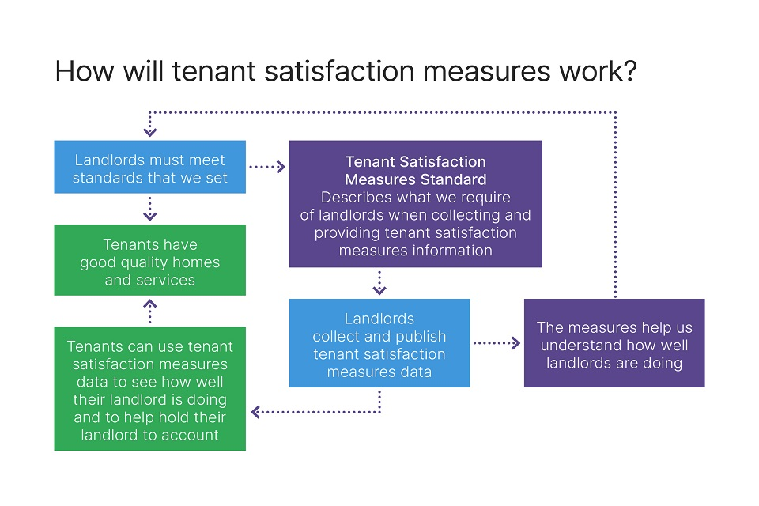

Slide 4
Tenant Satisfaction Measures
There are 22 tenant satisfaction measures, covering five themes:
  Keeping properties in good repair
  Maintaining building safety
  Respectful and helpful engagement
  Effective handling of complaints
  Responsible neighbourhood management
Ten of these measures will be reported by Property Services through the National Register of Social Housing (NROSH) , and 12 will be measured through carrying out tenant perception surveys.
The results of the perception surveys will be published and shared with residents and the Regulator of Social Housing

Slide 5
Tenant Satisfaction Measures - measured by landlord directly
Keeping properties in good repair
Homes that do not meet the Decent Homes Standard
Repairs completed within target timescale
Maintaining building safety
Gas safety checks
Fire safety checks
Asbestos safety checks
Water safety checks
Lift safety checks
Effective handling of complaints
Complaints relative to the size of the landlord
Complaints responded to within Complaint Handling Code timescales
Responsible neighbourhood management
Anti-social behaviour cases relative to the size of the landlord

Slide 6
Tenant Satisfaction Measures – measured by tenant perception survey
Overall satisfaction
Keeping properties in good repair
  Satisfaction with repairs
  Satisfaction with time taken to complete most recent repair
  Satisfaction that the home is well maintained
Maintaining building safety
  Satisfaction that the home is safe
Effective handling of complaints
  Satisfaction with the landlord’s approach to handling complaints

Slide 7
Tenant Satisfaction Measures – measured by tenant perception survey
Respectful and helpful engagement
  Satisfaction that the landlord listens to tenant views and acts upon them
  Satisfaction that the landlord keeps tenants informed about things that matter to them
  Agreement that the landlord treats tenants fairly and with respect
Responsible neighbourhood management
  Satisfaction that the landlord keeps communal areas clean and well maintained
  Satisfaction that the landlord makes a positive contribution to neighbourhoods
  Satisfaction with the landlord’s approach to handling anti-social behaviour

Slide 8
Tenant Perception Survey Results 2024/25

Slide 9
Tenant Perception Survey 2024/25
In January 2025 Refuge launched its first Tenant Perception Survey.
As Refuge is a small provider, a census approach was taken and all tenants within scope were given the opportunity to respond to the survey.
The survey applied to 96 residents who live in properties that Refuge either own or lease and who have signed a Refuge Licence Agreement.
A total of 34 (35%) residents completed the survey, this percentage assumes full occupancy.
Refuge only issues licences but the term “tenant” will be used for the purposes of this report.
The survey was anonymous so individual residents and properties could not be identified to encourage participation
The small sample size should be considered when drawing conclusions from these results

Slide 10

Summary of tenant perception survey results – overall satisfaction
92% of tenants, taking everything into account were very satisfied or fairly satisfied with Refuge’s accommodation services

Slide 11
Summary of tenant perception survey results – repairs and engagement
Keeping properties in good repair
92% of tenants were very or fairly satisfied with Refuge’s repair services
84% of tenants were very or fairly satisfied with Refuge’s repair response times
97% of tenant were very or fairly satisfied that Refuge provides a home that is safe and well maintained
80% of tenants were very or fairly satisfied that Refuge keeps communal areas clean, safe and well maintained
Respectful and helpful engagement
85% of tenants were very or fairly satisfied with the way Refuge keeps them informed about things that matter to them as a resident.
85% of tenants strongly agreed or agreed that Refuge treats them with respect.
82% of tenants were very or fairly satisfied with the extent to which Refuge listens to their views and acts upon them

Slide 12
Summary of tenant perception survey results – complaints and neighbourhood management
Effective handling of complaints
74% of tenants were very or fairly satisfied with Refuge’s approach to handling complaints
71% of tenants strongly agreed or agreed with the statement “I know how to make a complaint to Refuge if I am not happy with the service I receive”.
Responsible neighbourhood management
79% of tenants were very or fairly satisfied with their neighbourhood as a place to live
73% of tenants were very or fairly satisfied with Refuge’s approach to handling anti-social behaviour

Slide 13
Areas for improvement
18% (6) of tenants did not know how to make a complaint
16% (4) of tenants were very or fairly dissatisfied with cleanliness, safety and maintenance of communal areas
12% (4) of tenants were fairly or very dissatisfied with Refuge’s approach to handling complaints
12% (4) of tenants were very or fairly dissatisfied with the extent to which Refuge listens to and acts upon their views
9% (3) of tenants disagreed or strongly disagreed with the statement “my landlord treats me with respect”.
9% (3) of tenants were fairly or very dissatisfied with the way Refuge keeps them informed about things that matter to them as a resident

Slide 14
Areas for improvement
6% (2) of tenants were very or fairly dissatisfied with their neighbourhood as a place to live
3% (1) of tenants very dissatisfied with Refuge’s approach to handling anti-social behaviour
3% (1) of tenants, taking everything into account was fairly dissatisfied with Refuge’s accommodation services
The small sample size makes it difficult to draw general conclusions from this data, however the experience every survivor in our refuges is important.

Slide 15
1. Taking everything into account, how satisfied are you with the accommodation service provided by Refuge?

Slide 16
If yes, how satisfied are you with the repairs service you received to your home from Refuge over the past 12-months?
Has Refuge carried out a repair to your home in the last 12-months?
No residents were fairly or very dissatisfied with the repairs service.

Slide 17
If yes, how satisfied or dissatisfied are you with the time taken to complete your most recent repair after you reported it

Slide 18
Thinking about the building you live in. How satisfied or dissatisfied are you that Refuge provides a home that is well maintained and safe for you to live in?

Slide 19
How satisfied or dissatisfied are you with the extent to which Refuge listens to your views and acts upon them?

Slide 20
How satisfied or dissatisfied are you that Refuge keeps you informed about things that matter to you as a resident?

Slide 21
To what extent do you agree or disagree with the following ‘my landlord treats me with respect”?

Slide 22
If yes how satisfied or dissatisfied are you that Refuge keeps these communal areas clean, safe and well maintained?
Do you live in a building with communal areas, either inside or outside, that you share with other people who live in the building?

Slide 23
How satisfied or dissatisfied are you with your neighbourhood as a place to live?

Slide 24
How satisfied or dissatisfied are you with Refuge’s approach to handling anti-social behaviour?

Slide 25
How satisfied or dissatisfied are you with Refuge’s approach to handling complaints?

Slide 26
To what extent do you agree or disagree with the following ‘I know how to make a complaint to Refuge if I am not happy with the service I receive’?

